Slide 1

SIDDHARTH INSTITUTE OF ENGINEERING & TECHNOLOGY
(AUTONOMOUS)
(Approved by AICTE, New Delhi, Affiliated to JNTUA, Ananthapuramu)
(Accredited by NBA for CIVIL, EEE, MECH, ECE & CSE and Accredited by NAAC with ‘A+’ Grade)
Puttur -517583, Tirupati District, A.P
Department of Computer Science and Engineering
Zeroth Review of Final Year Project
Title of Project: “Type your TITLE here”
Batch Details
S.No. | Roll No. | Name of the Student | Internal Guide
1 | 21F61A0501 | WWW | Dr.R.G.Kumar, M.Tech, Ph.D Associate Professor, Dept. of CSE
2 | 21F61A0501 | XXXX
3 | 21F61A0501 | YYY
4 | 21F61A0501 | ZZZ
5 | - | Remove this row if not applicable

Slide 2
INTRODUCTION
Music classification plays a key role in personalized recommendations, helping users discover tracks tailored to their tastes.
Machine learning can automate genre identification, enabling systems to analyze vast amounts of audio data efficiently.
This project integrates audio feature extraction, machine learning model training, and a user-friendly interface to classify genres with high precision.
The ultimate aim is to enhance music streaming services and personalized playlists.

Slide 3
PROBLEM STATEMENT
Manual classification of music genres is time-consuming, error-prone, and subjective.
Current systems often fail to generalize across diverse datasets, leading to subpar performance in real-world applications.
There is a growing demand for an automated solution capable of real-time predictions to meet the expectations of modern music listeners.
Addressing these challenges can improve the personalization of music streaming services.

Slide 4
EXISTING SYSTEM
Traditional approaches rely heavily on manual tagging by music experts or simplistic rule-based systems.
Basic audio features like tempo or pitch are utilized, but they fail to capture the complexities of music.
Limitations include:
Poor adaptability to evolving musical trends and diverse genres.
Inability to handle large-scale datasets efficiently.
Lack of advanced techniques like dimensionality reduction or feature optimization.

Slide 5
LIMITATIONS OF EXISTING SYSTEM
High dependency on manual intervention limits scalability and introduces subjectivity.
Limited accuracy in distinguishing between genres with subtle differences.
Inefficiency in processing and analyzing large datasets restricts usability in commercial applications.

Slide 6
PROPOSED SYSTEM
Automates music genre classification using advanced machine learning techniques.
Extracts detailed audio features using the librosa library, capturing the nuances of music.
Trains multiple machine learning models, including SVM, KNN, Decision Trees, and Neural Networks, with rigorous hyperparameter tuning to ensure optimal performance.
Provides real-time predictions through a user-friendly Streamlit interface, designed for ease of use and accessibility.

Slide 7
ADVANTAGES OF PROPOSED SYSTEM
Significantly improved accuracy due to advanced feature extraction and model optimization.
Scalable to handle extensive datasets spanning diverse music genres.
Real-time prediction capability ensures seamless integration with music streaming platforms.
Supports personalized user experiences by enabling accurate genre-based recommendations.

Slide 8
ABSTRACT
This project focuses on developing an automated system for classifying music genres using machine learning.
By extracting key audio features and training models, the system achieves high accuracy and efficiency.
The implementation includes a real-time prediction interface that enhances user interaction and experience.
Future enhancements could include expanding the system for multi-label classification and other audio-based applications.

Slide 9
OBJECTIVES
To develop a robust system for extracting relevant audio features using advanced signal processing techniques.
To train and evaluate multiple machine learning models, selecting the best-performing one for deployment.
To create an interactive, real-time genre prediction interface for practical use.
To achieve high classification accuracy and scalability for diverse music datasets.

Slide 10
LITERATURE SURVEY
S.No | Title of the Paper | Year of Publication | Author | Comments
1 | Supervised learning and unsupervised learning on music data with different genres | 2021 | 1. Chunang Liu 2. Zehan Chao | Discusses ML techniques in the context of music analytics

Slide 11
PROPOSED SOLUTION
Extract features using librosa for detailed audio analysis (e.g., MFCC, chroma_stft, spectral centroid).
Train various machine learning models like SVM, KNN, Decision Trees, and Neural Networks, ensuring robust evaluation.
Optimize models using GridSearchCV to identify the best hyperparameters for each algorithm.
Develop an intuitive interface using Streamlit, allowing users to upload audio files and receive genre predictions in real time.

Slide 12
SCOPE OF THE PROJECT
This project targets high accuracy and efficiency in classifying multiple music genres.
It supports applications in music streaming, playlist creation, and automated tagging for large music libraries.
The framework is extendable to other audio classification tasks, such as emotion recognition or speech analysis.

Slide 13
METHODOLOGY
Data Collection: Use the GTZAN dataset, which includes audio tracks across multiple genres.
Preprocessing: Scale features for uniformity, encode labels for training, and apply PCA for dimensionality reduction.
Feature Extraction: Extract and store relevant audio using librosa.
Model Training: Train and evaluate models like SVM, KNN, Decision Trees, and Neural Networks, optimizing performance through hyperparameter tuning.
Evaluation: Use metrics like accuracy, precision, recall, and F1-score to compare model performance.

Slide 14
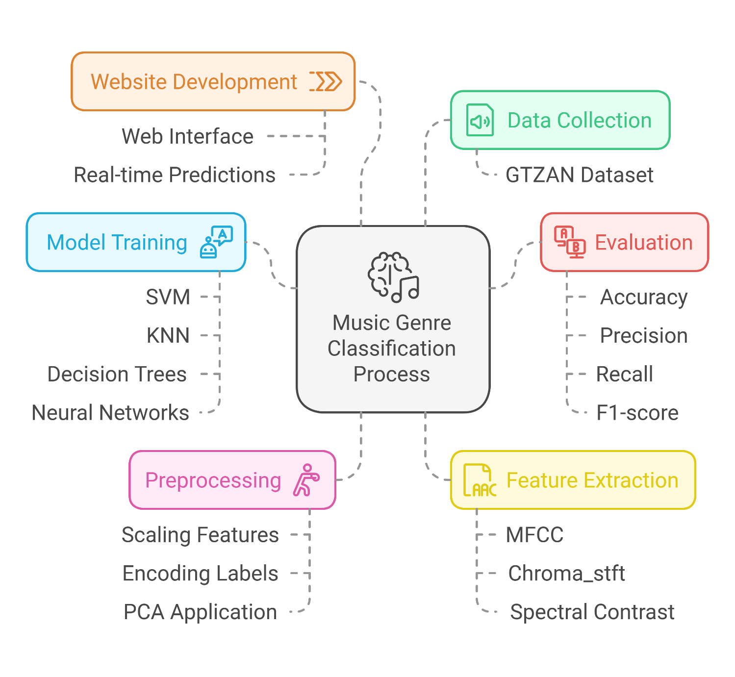
METHODOLOGY

Slide 15
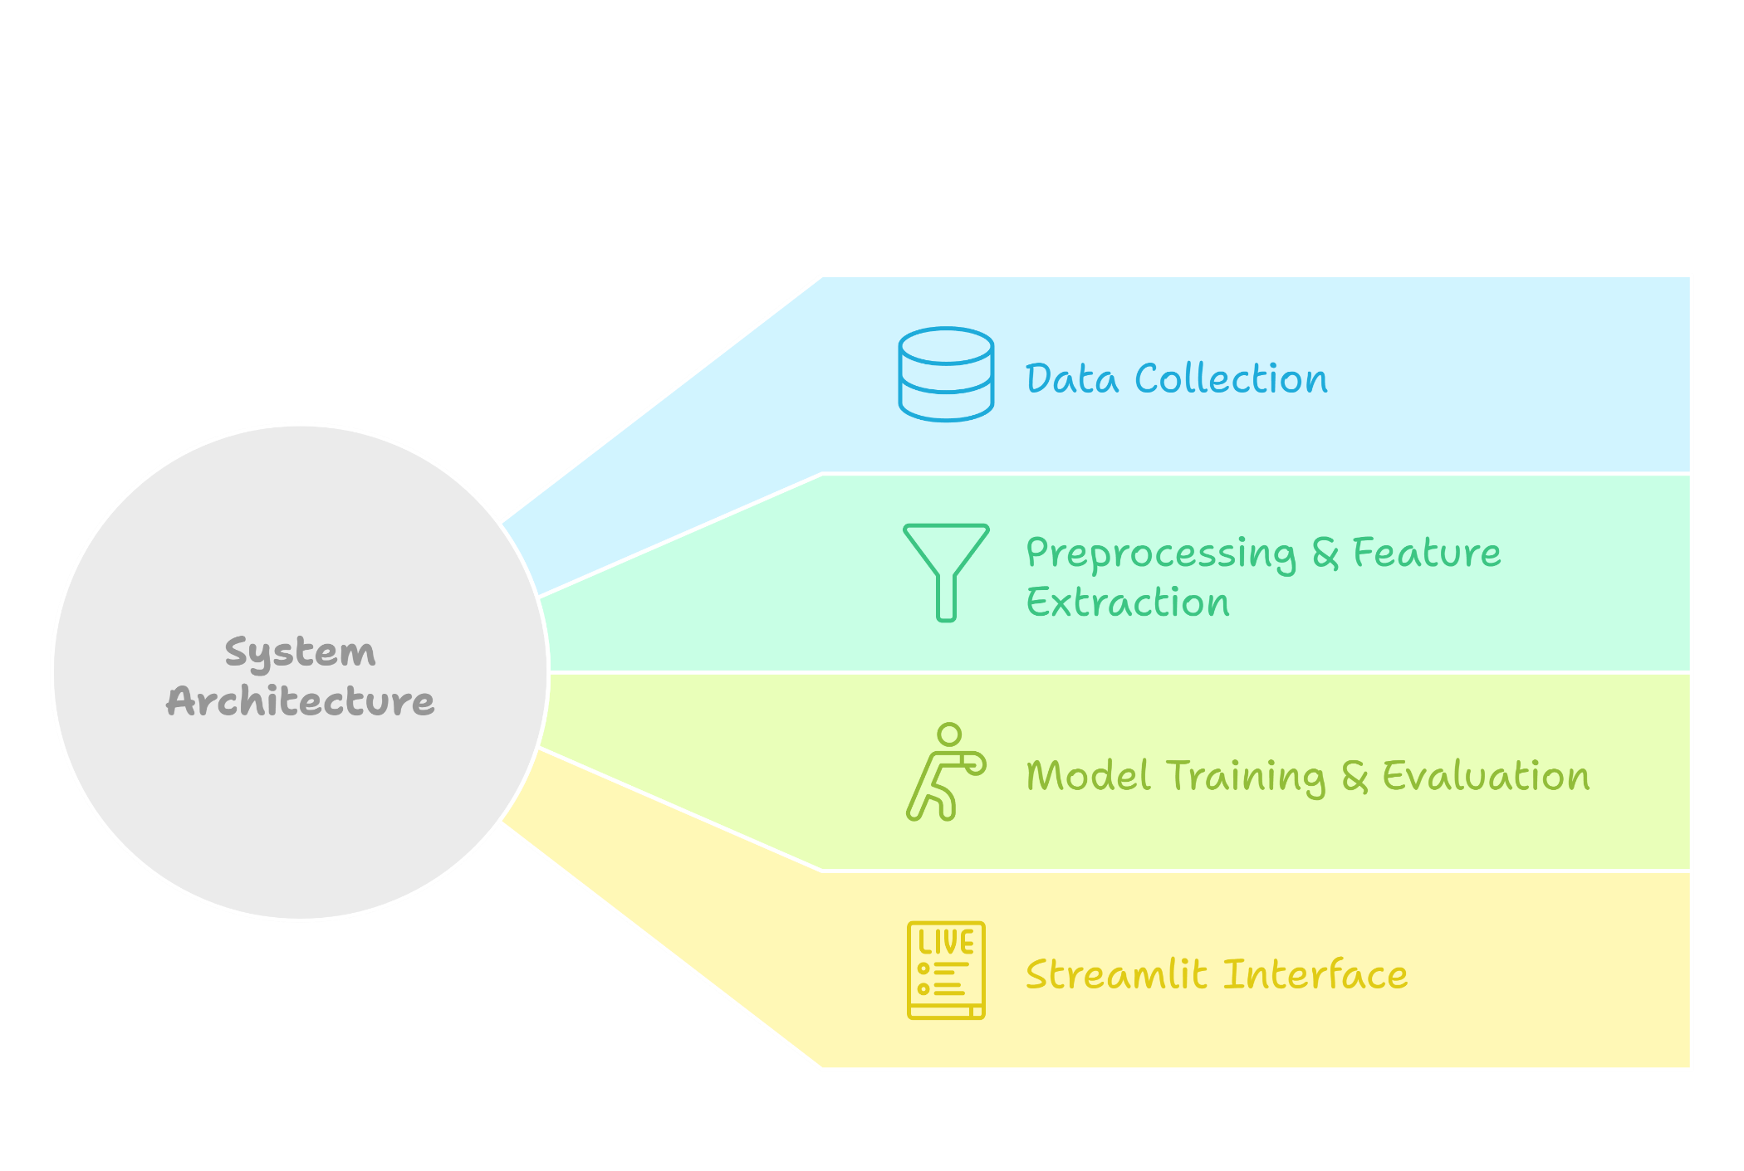
ARCHITECTURAL DIAGRAM

Slide 16
EXPECTED OUTCOMES
Achieve a high classification accuracy (>90%) for music genres.
Deliver a scalable solution capable of handling diverse and extensive datasets.
Provide a real-time prediction interface that is intuitive and user-friendly.
Enhance the personalization of music recommendations on streaming platforms.

Slide 17
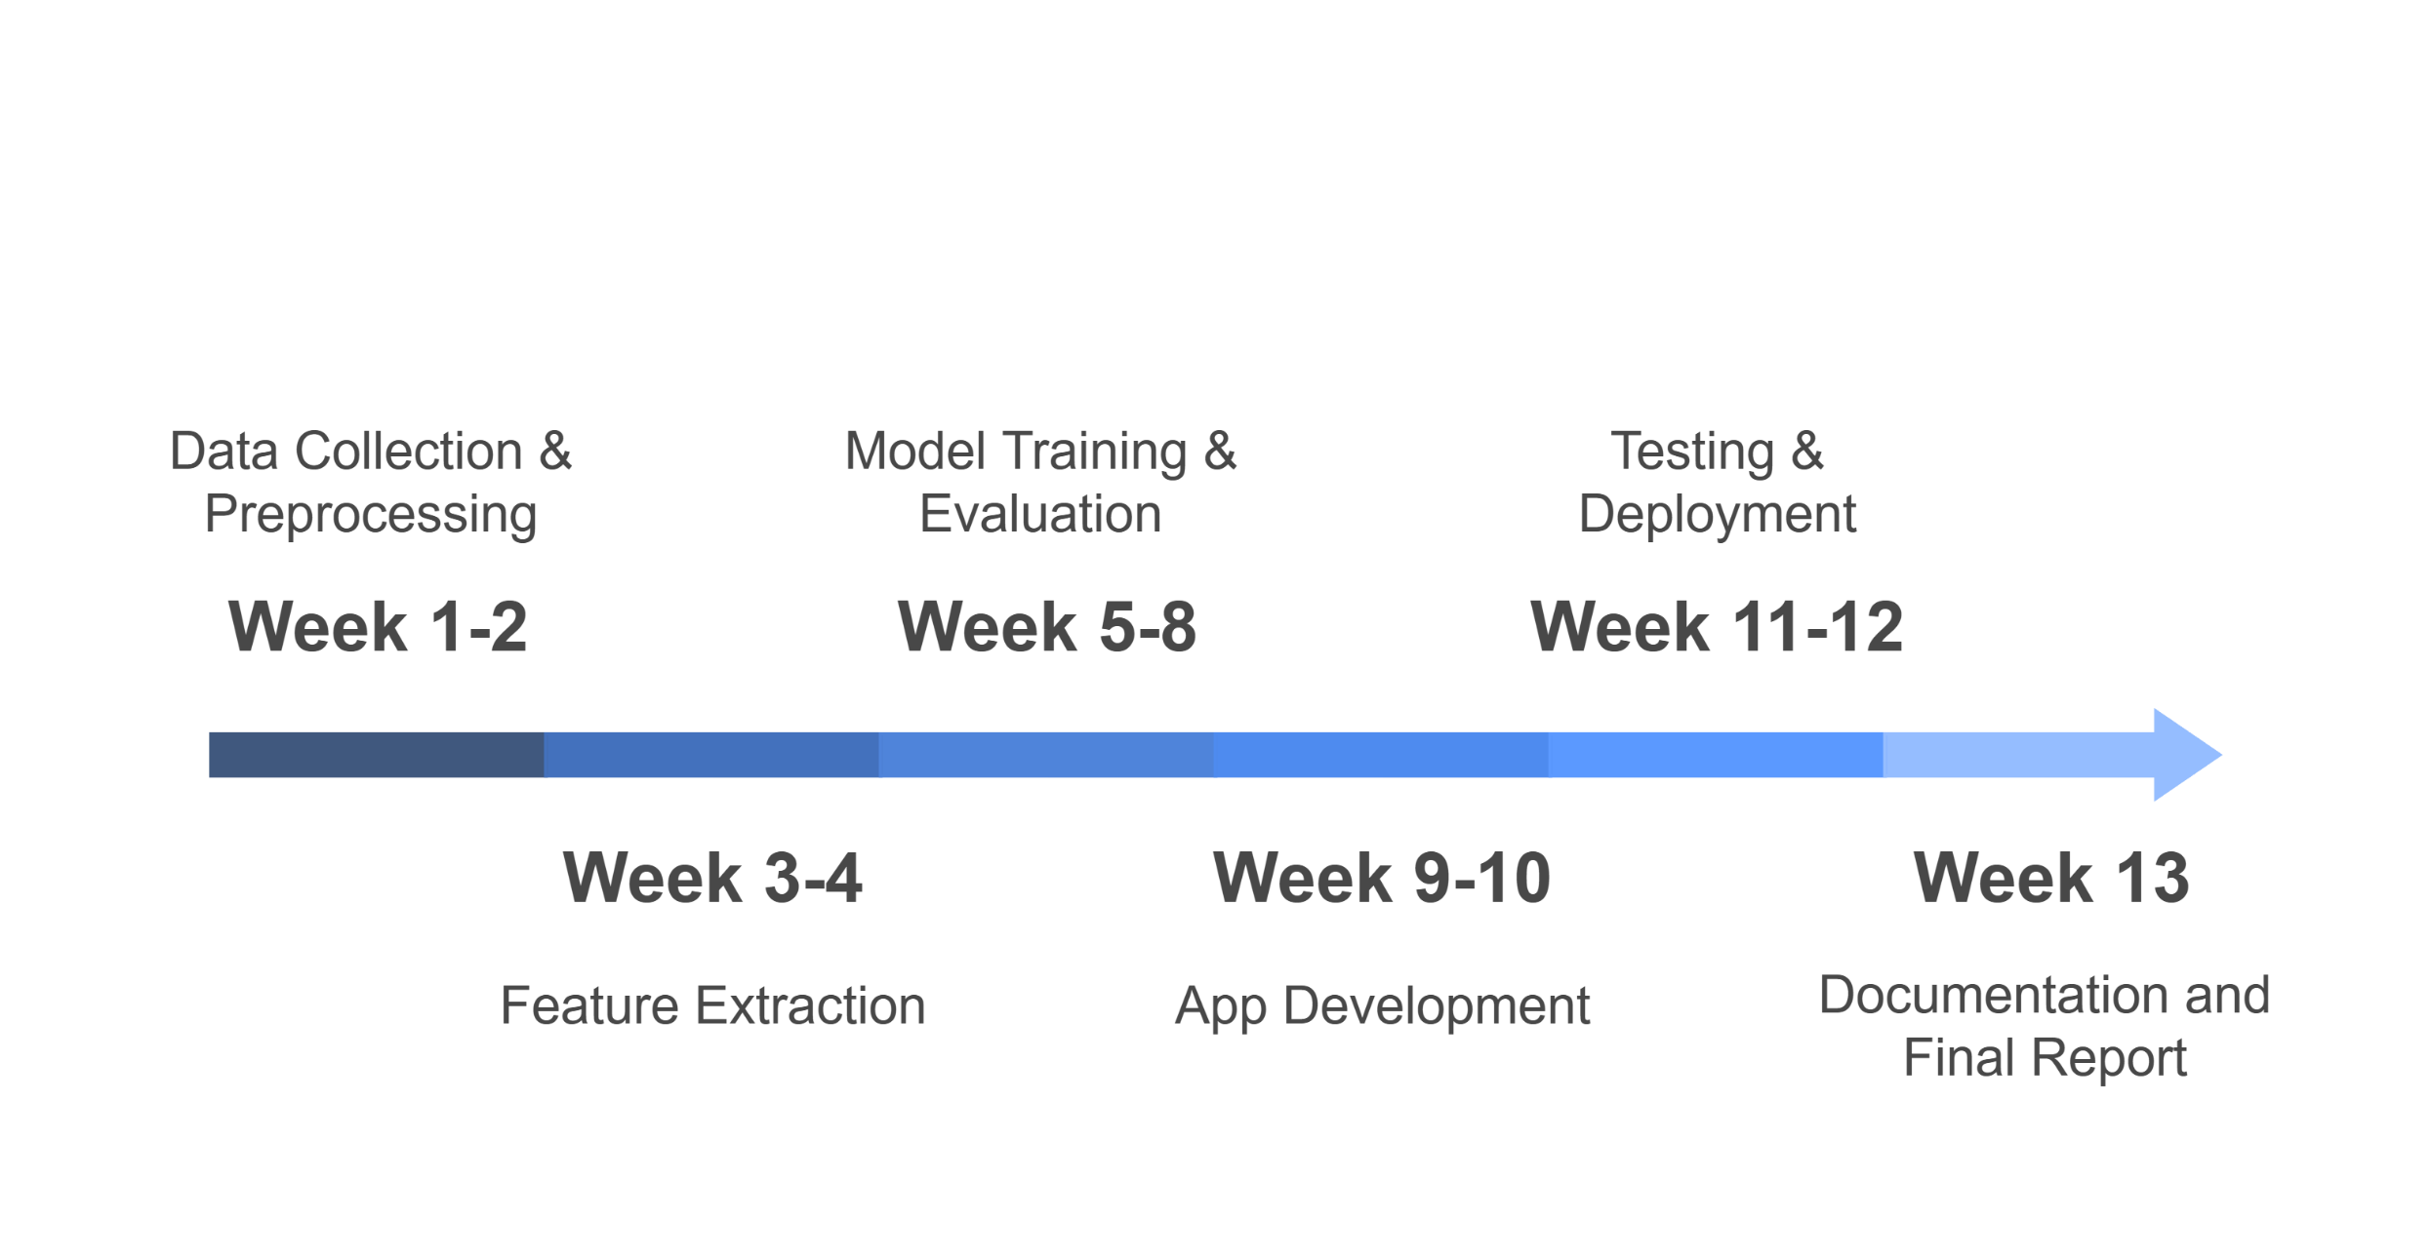
TIMELINE

Slide 18
TOOLS AND TECHNOLOGIES
Libraries: librosa for audio analysis, scikit-learn for model training.
Programming Language: Python, chosen for its extensive libraries and community support.
IDE: Jupyter Notebook for prototyping, VS Code for development.
Dataset: GTZAN, a widely used dataset in music genre classification research.

Slide 19
REFERENCES
librosa: Audio and Music Signal Analysis in Python 🔗
GTZAN Dataset documentation 🔗
Scikit-learn: Machine Learning in Python 🔗

Slide 20
CONCLUSION
This project successfully automates music genre classification, addressing the limitations of manual and traditional methods.
The solution provides a scalable and efficient framework, with potential applications in streaming services and music analysis.
Future work includes multi-label classification and expanding to other audio analysis tasks, enhancing versatility and impact.

